Slide 1
2.5 Floating-Point Representation
The signed magnitude, one’s complement, and two’s complement representation that we have just presented deal with signed integer values only.
Without modification, these formats are not useful in scientific or business applications that deal with real number values.
Floating-point representation solves this problem.

Slide 2
2.5 Floating-Point Representation
If we are clever programmers, we can perform floating-point calculations using any integer format.
This is called floating-point emulation, because floating point values aren’t stored as such; we just create programs that make it seem as if floating-point values are being used.
Most of today’s computers are equipped with specialized hardware that performs floating-point arithmetic with no special programming required.

Slide 3
2.5 Floating-Point Representation
Floating-point numbers allow an arbitrary number of decimal places to the right of the decimal point.
  For example: 0.5 × 0.25 = 0.125
They are often expressed in scientific notation.
  For example:
    0.125 = 1.25 × 10⁻¹
    5,000,000 = 5.0 × 10⁶

Slide 4
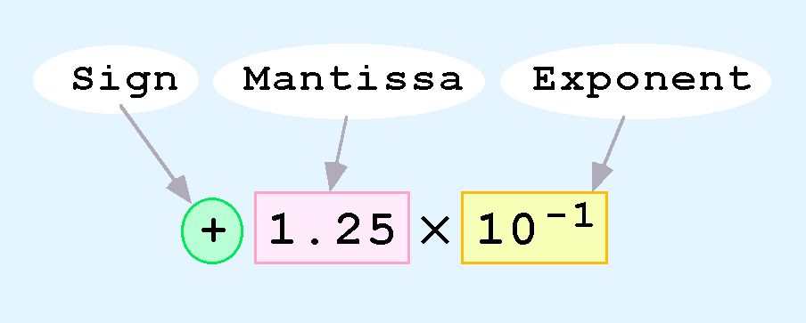
2.5 Floating-Point Representation
Computers use a form of scientific notation for floating-point representation
Numbers written in scientific notation have three components:

Slide 5
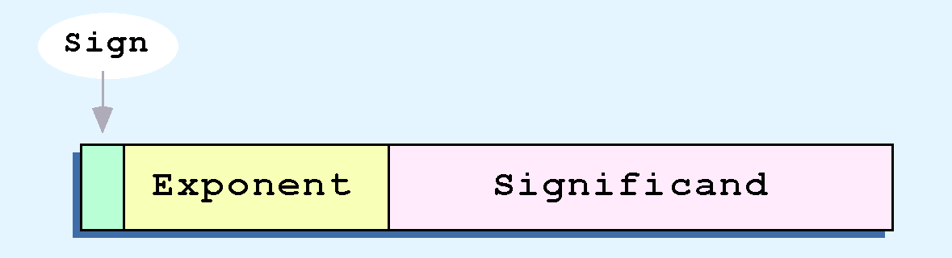
2.5 Floating-Point Representation
Computer representation of a floating-point number consists of three fixed-size fields:
This is the standard arrangement of these fields.
Note: Although “significand” and “mantissa” do not technically mean the same thing, many people use these terms interchangeably. We use the term “significand” to refer to the fractional part of a floating point number.

Slide 6
2.5 Floating-Point Representation
We introduce a hypothetical “Simple Model” to explain the concepts
In this model:
  A floating-point number is 14 bits in length
  The exponent field is 5 bits
  The significand field is 8 bits

Slide 7
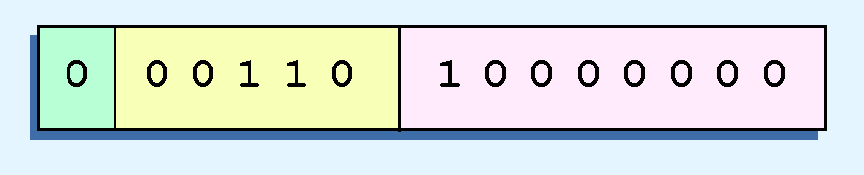
2.5 Floating-Point Representation
Example:
  Express 32₁₀ in the simplified 14-bit floating-point model.
We know that 32 is 2⁵. So in (binary) scientific notation 32 = 1.0 x 2⁵ = 0.1 x 2⁶.
  In a moment, we’ll explain why we prefer the second notation versus the first.
Using this information, we put 110 (= 6₁₀) in the exponent field and 1 in the significand as shown.

Slide 8
2.5 Floating-Point Representation
The IEEE has established a standard for floating-point numbers
The IEEE-754 single precision floating point standard uses an 8-bit exponent (with a bias of 127) and a 23-bit significand.
The IEEE-754 double precision standard uses an 11-bit exponent (with a bias of 1023) and a 52-bit significand.

Slide 9
2.5 Floating-Point Representation
In both the IEEE single-precision and double-precision floating-point standard, the significant has an implied 1 to the LEFT of the radix point.
  The format for a significand using the IEEE format is: 1.xxx…
  For example, 4.5 = .1001 x 2³ in IEEE format is 4.5 = 1.001 x 2². The 1 is implied, which means is does not need to be listed in the significand (the significand would include only 001).

Slide 10
2.5 Floating-Point Representation
Example: Express -3.75 as a floating point number using IEEE single precision.
First, let’s normalize according to IEEE rules:
  3.75 = -11.11₂ = -1.111 x 2¹
  The bias is 127, so we add 127 + 1 = 128 (this is our exponent)
  The first 1 in the significand is implied, so we have:
  Since we have an implied 1 in the significand, this equates to
    -(1).111₂ x 2 ^{(128 – 127)} = -1.111₂ x 2¹ = -11.11₂ = -3.75.
(implied)

Slide 11
2.6 Character Codes
Calculations aren’t useful until their results can be displayed in a manner that is meaningful to people.
We also need to store the results of calculations, and provide a means for data input.
Thus, human-understandable characters must be converted to computer-understandable bit patterns using some sort of character encoding scheme.

Slide 12
2.6 Character Codes
Binary-coded decimal (BCD) was one of these early codes. It was used by IBM mainframes in the 1950s and 1960s.
Decimal Digit | BCD 8 4 2 1
0 | 0 0 0 0
1 | 0 0 0 1
2 | 0 0 1 0
3 | 0 0 1 1
4 | 0 1 0 0
5 | 0 1 0 1
6 | 0 1 1 0
7 | 0 1 1 1
8 | 1 0 0 0
9 | 1 0 0 1

Slide 13
2.6 Character Codes
In 1964, BCD was extended to an 8-bit code, Extended Binary-Coded Decimal Interchange Code (EBCDIC). See textbook Page 89
EBCDIC was one of the first widely-used computer codes that supported upper and lowercase alphabetic characters, in addition to special characters, such as punctuation and control characters.
EBCDIC and BCD are still in use by IBM mainframes today.

Slide 14
2.6 Character Codes
Other computer manufacturers chose the 7-bit ASCII (American Standard Code for Information Interchange) as a replacement for 6-bit codes.
see textbook page 90.
While BCD and EBCDIC were based upon punched card codes, ASCII was based upon telecommunications (Telex) codes.
Until recently, ASCII was the dominant character code outside the IBM mainframe world.

Slide 15
2.6 Character Codes
Many of today’s systems embrace Unicode, a 16-bit system that can encode the characters of every language in the world.
  The Java programming language, and some operating systems now use Unicode as their default character code.
The Unicode codespace is divided into six parts. The first part is for Western alphabet codes, including English, Greek, and Russian.

Slide 16
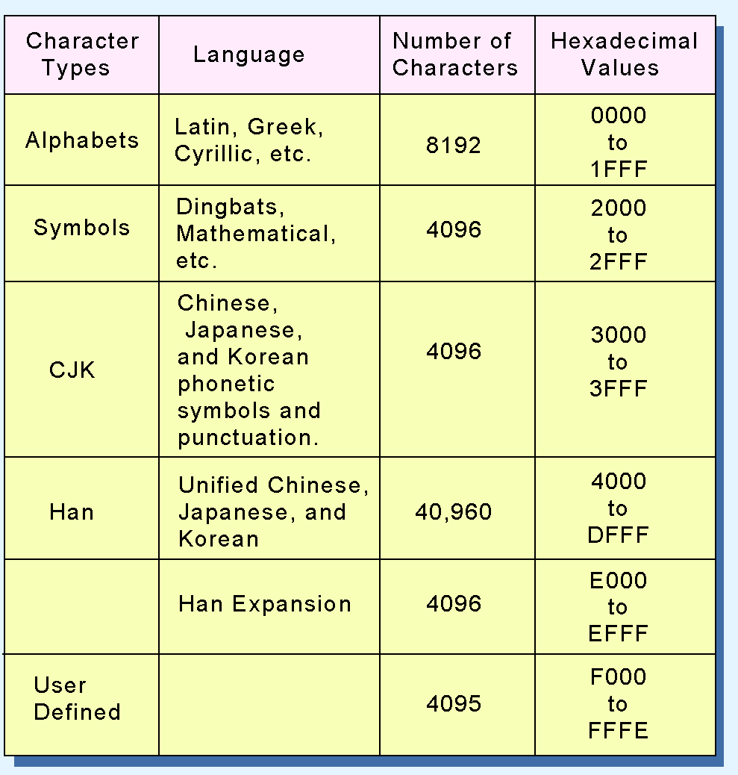
2.6 Character Codes
The Unicode codes- pace allocation is shown at the right.
The lowest-numbered Unicode characters comprise the ASCII code.
The highest provide for user-defined codes.

